Slide 1
FTCS Roadmap
Service Architecture Work Shop
BITECH

Slide 2
MDT Utility
Kraken Service Demo

Slide 3





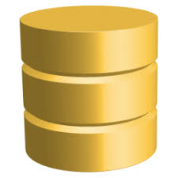
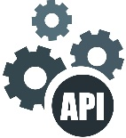
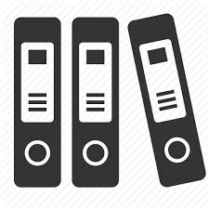


Service Oriented Architecture
SOA is an architectural style for designing and building business applications using loosely coupled and business capability-driven services. Hence, Boeing is following the Service-Oriented Architecture approach as it is supported with the following benefits:
SOA is about business alignment with IT.
SOA is centered on the concept of services as building blocks.
Services can be composed into larger building blocks and applications.
Services have many classifications but the primary focus of SOA is to create services that represent repeatable business tasks. One example is a service that Creates Purchase Orders.
OAuth 2.0
---------
JWT
User Credentials /
Token Based
Service A
Data Base
Micro service
WSSO
Synchronous
Service B
Micro service
File Store
Service C
Micro service
WSSO
Meta / Reference
Data
Asynchronous

Slide 4
Service Patterns Synchronous and Asynchronous Communication
It is possible to use both asynchronous and synchronous communication together. Centralized orchestration, enables both synchronous and asynchronous communication. The orchestrator sequences the various service calls based on a defined workflow. That sequence is not embedded within the participating services. The business workflow knowledge resides in a centralized place, and the services focus solely on their individual responsibilities.

Slide 5
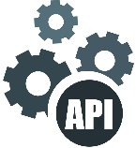
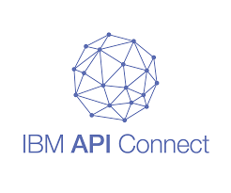
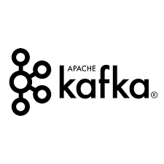



Unified Solution
Design a Generic SOA Layer Solution as a centralized Communication framework to integrate multiple systems with FTCS Core Services.
SOA – System Integrations Solution
FTCS Systems
Service A
Micro service
Client
Client API / Event Trigger
Service B
Micro service
Service C
Micro service

Slide 6
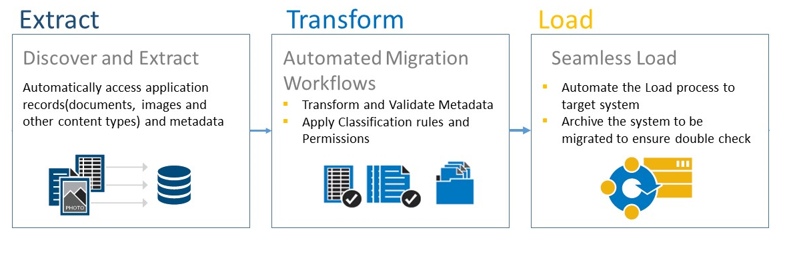
Data Migration and Conversation Strategy
Data migration and conversion strategy plays a key role to achieve the Data transformation.
Our potential business drivers that are essential for an effective data migration will be :
Data Accuracy
Migration Speed
Low or no Downtime
Minimum costs
Most migrations take place through these major stages:
Extraction: remove data from the current system to begin working on it.
Transformation: match data to its new forms, ensure that metadata reflects the data in each field.
Cleansing: de-duplicate, run tests, and address any corrupted data.
Validation: test and re-test that moving the data to the target location provides the expected response.
Loading: transfer data into the new system, and review for errors again.

Slide 7
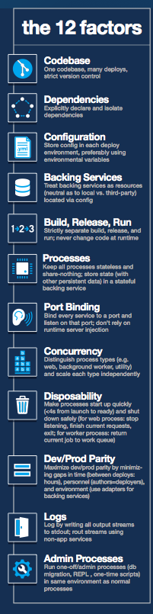
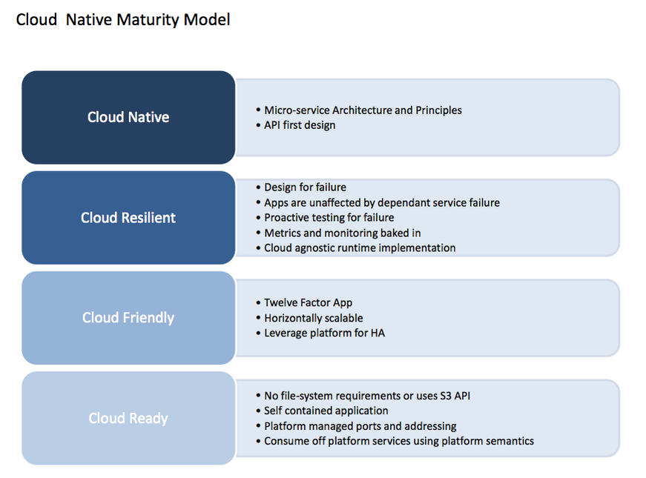
Cloud Adoption and 12 Factors
Twelve-factor application is a methodology for building distributed applications that can run on the cloud platform and can be delivered as a service.
Some factors may seem self-evident to developers today, interest in developing applications that adhere to common best practices continues to grow with the rise of applications that are composed of loosely-coupled services and common Integration patterns.

Slide 8
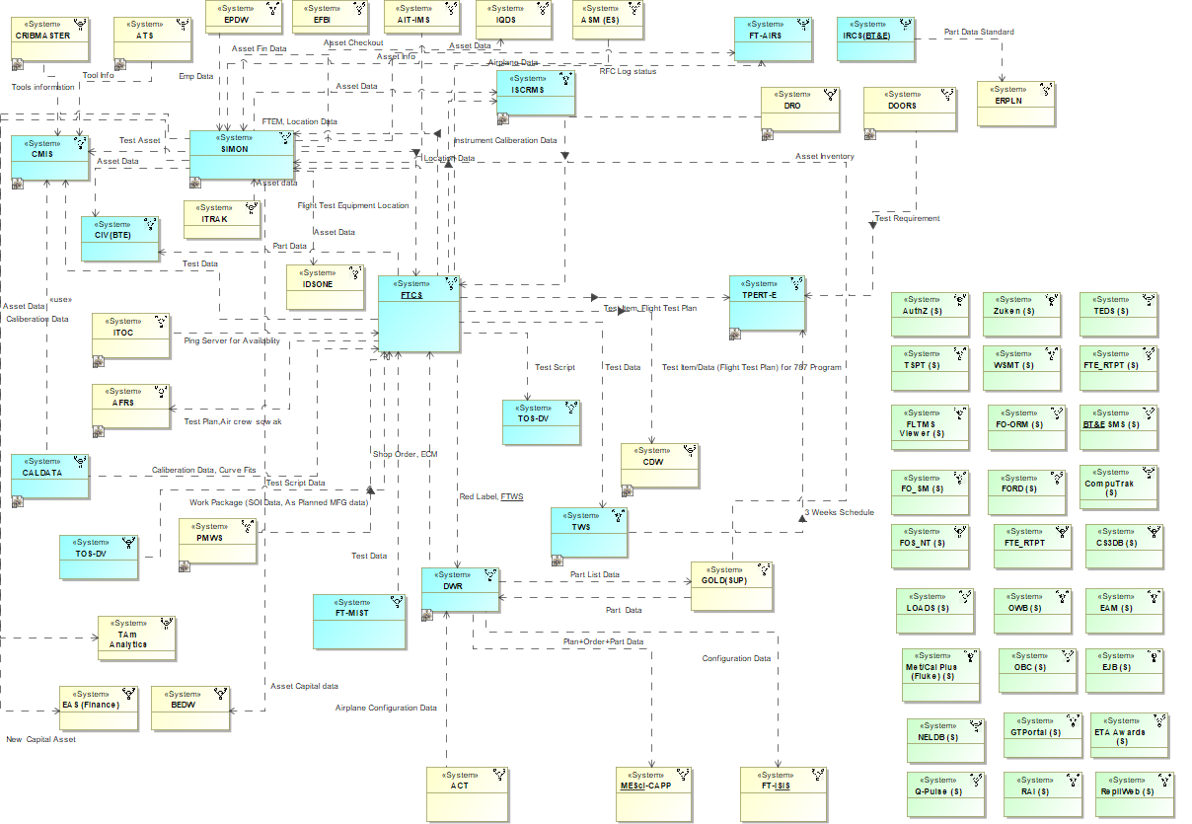
System of System Mapping of BT&E applications – Integration Strategy

Slide 9
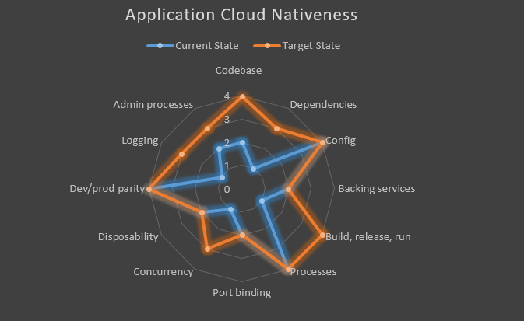
Cloud Readiness Assessment
As part of the Product System Initiative , we recently performed the cloud readiness assessment to measure the parameters of our existing application’s landscape to analyze the technology liability.
Following slides talk about near term implementations that can be performed to some extent to start adapting emerging technologies and solutions for FTCS / MIST applications.

Slide 10
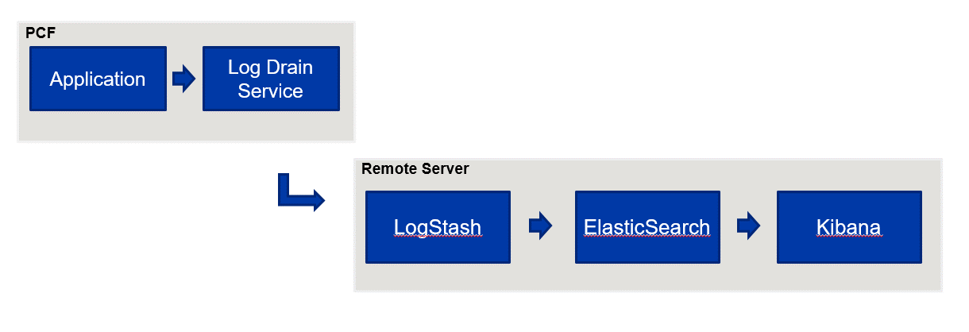
Dependency Management
Current Stage: Application relies on implicit existence of system-wide packages/files/configuration. MIST is using ANT build libraries.
Recommended Stage: Application dependencies except runtime are declared and defined explicitly externally in the files such as POM.xml, build.gradle etc.
Solution as per recommendation: Migrate Ant to Maven
FTCS: Migration to Maven is really complex as FTCS has n number of ANT tasks. Hence planning to add Apache Ivy plugin for managing dependencies.
Logging
Current Stage: Basic logging mechanism implemented using log4J and stored as files.
Recommended Stage: Events to be logged unbuffered as stream. Manage logs as unbuffered streams. It is also recommended to aggregate logs and analyze it.
Solution as per recommendation: ELK(Elastic Logstash Kibana)

Slide 11
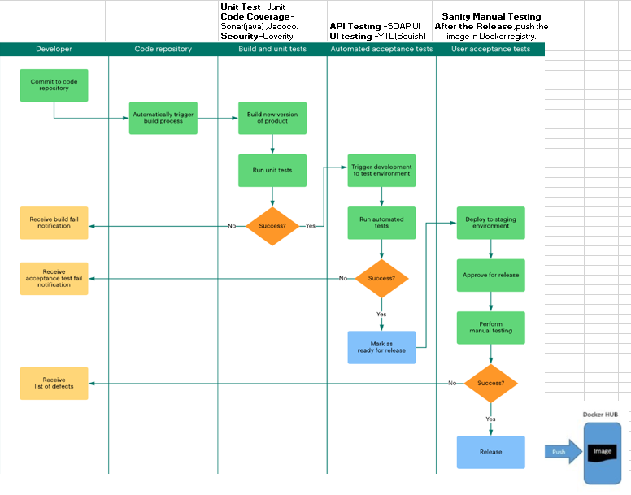
DevOps pipeline
Current Stage: No CI/CD implemented and build is done manually.
Recommended Stage: Should have strict separation between the build, deploy and release and run stages using CI/CD devOps.
Solution as per recommendation: TFS CI/CD pipeline implementation.
Note: We use IBM Synergy for build in the higher environments.

Slide 12
Code Base:
Current Stage: Application uses Boeing Approved VC (TFS GIT), but we are using IBM Synergy as a Artifactory for storing binaries/prop/config files and IBM synergy is used for PROD deployment.
Recommended Stage: Use Boeing approved version control systems like GIT or TFS etc… Deploy from single code repository managed by VCS for each app
Solution as per recommendation: TFS Internal Artifactory (or) Jfrog
Note: Synergy dependency with Seattle Team in terms of approval and understanding the existing process.
Concurrency , Admin process:
Concurrency:
Recommended: Scaling vertically (by adding more thread /process to handle multiple users) and/or scale horizontally(by adding more systems) .
But might not be required as currently production load is around 120 , so might not require scaling.
Admin Process:
Currently in MIST: Admin processes, cron jobs like DB migration, background processes are isolated from the code.
Recommended: Run admin process as isolated one such as DB migration and background jobs.
It is not required as of now , as there are no plans of migrating the database to cloud.

Slide 13
Action items
S.No. | Work Item | Current status | Recommended solution
1 | Dependency Management | MIST uses ANT build libraries. | Maven dependency management tool
2 | Logging | Log4J | ELK implementation
3 | DevOps Pipeline | Manual build | CI/CD pipeline implementation
4 | Code base |  | TFS Internal Artifactory (or) Jfrog

Slide 14





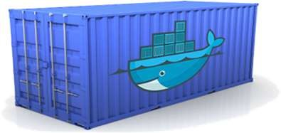





Containers
Containers are an executable unit of software in which application code is packaged, along with its libraries, dependencies and related configuration files, in common ways so that it can be run anywhere, whether it be on desktop, traditional IT infrastructure, or the cloud.
Static website
User DB
Web frontend
Queue
Analytics DB
Build once, run anywhere
Configure once, run anything
Development VM
QA Server
Production Cluster
Data Centers
Public Cloud
Build, Ship and Run

Slide 15
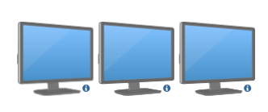

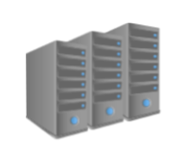
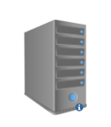
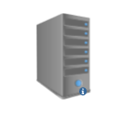


Evolution of Containerization
Say, you have three different Java based application that you plan to host it. Each of these application make use of different versions of Java as well as associated libraries and dependencies, differ from one application to application.
Traditional Model
Virtualization
Containerization
Dev Team
Dev Team
Dev Team
Ops Team
Ops Team
Ops Team

Slide 16
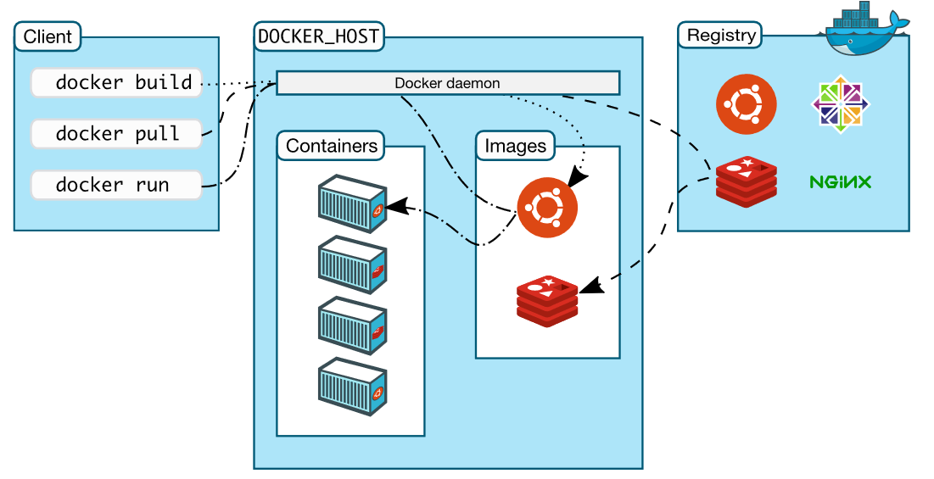
Docker Architecture
Docker user client-server architecture with these major components,
Docker Client
Docker daemon
Docker Registry

Slide 17
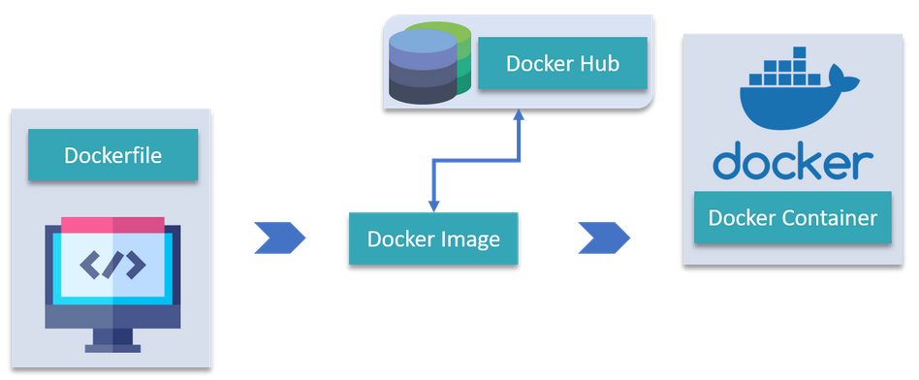
Docker Objects
DockerFile :
A Dockerfile is a text document which contains all the commands that a user can call on the command line to assemble an image. So, Docker can build images automatically by reading the instructions from a Dockerfile.
Images :
Images are nothing but a template which is used to create Docker containers. It also contain metadata that describe the container's capabilities and needs.
Containers :
Docker Container is a running instance of a Docker Image and they hold the entire package needed to run the application.
Pull/Push
Build
Run

Slide 18
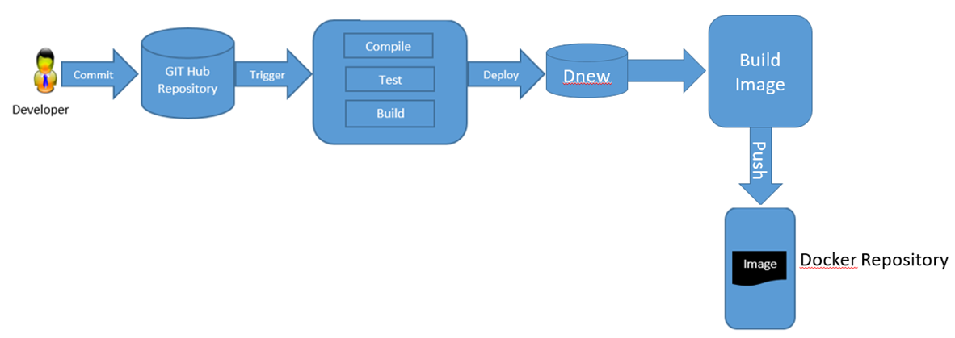
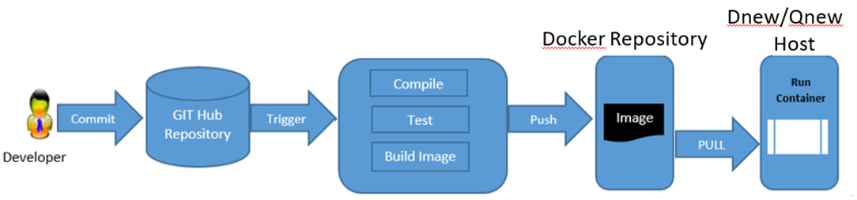
Continuous Integration – With Containers
Push Docker image
Push Docker image & deploy in container

Slide 19
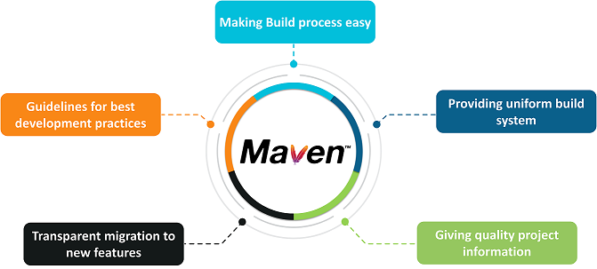
Centralized Repository - Maven Migration
What is Maven?
“Maven is a software management and comprehension tool based on the concept of Project Object Model (POM) which can manage project build, reporting, and documentation from a central piece of information”
What is POM?
“As a fundamental unit of work in Maven, POM is an XML file that contains information about project and configuration details used by Maven to build the project”

Slide 20
Main Features of MAVEN
Build-Tool
Dependency Management Tool
Documentation Tool
Comparison with ANT
One level above ANT
Higher level of reusability between builds
Faster turn around time to set up a powerful build
Less maintenance
Repository management
ANT | MAVEN
Target build.xml | Goal pom.xml

Slide 21
Important Points to consider:
In the current system dependencies and libraries are manually managed from external source.
Maven helps in managing all dependencies using dependency manager and artifactory from Boeing repository.
Maven makes easy to start project in different environments and one doesn't needs to handle the dependencies injection, builds, processing, etc ..
Most critical part in the migration is adding the dependencies in the POM by adding the dependencies for the frameworks used in application.
Right version of the jars must be added, if the jars don't exist in Sres repository then raise a request to SRES to add the jars (or) 3rd party JARs need to put in your local repository .
Any third party jars can be added to the repository using Maven install.
Benefits of Maven over Ant
Maven's default plugins and life cycle allow a project to perform common build actions without touching a build configuration file
Reduced duplication
Clear definition of used dependencies
Third party dependencies

Slide 22
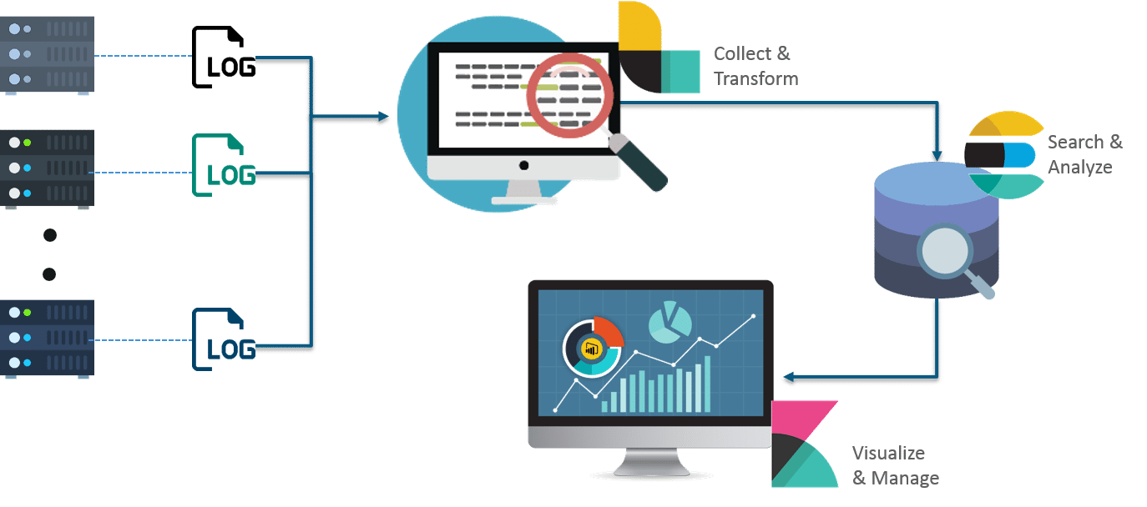
Transaction & Log Management - ELK stack (in PCF).
Elastic or ELK Stack is a complete end-to-end log analysis solution which helps in deep searching, analyzing and visualizing the log generated from different machines.
Elasticsearch is NoSQL data storage and it is distributed, RESTful search and analytics engine.
Logstash ingests data from a multiple sources simultaneously, process it, and then sends it to Elasticsearch.
Kibana is an open source analytics and visualization platform designed to work on top of Elasticsearch.

Slide 23
Log Flow & Demo
PCF
Application
Log Drain Service
Remote Server
LogStash
ElasticSearch
Kibana
Benefits
Improved System wide overview
Proactive application monitoring
Better Security
Log data accessibility
Easy Understanding

Slide 24
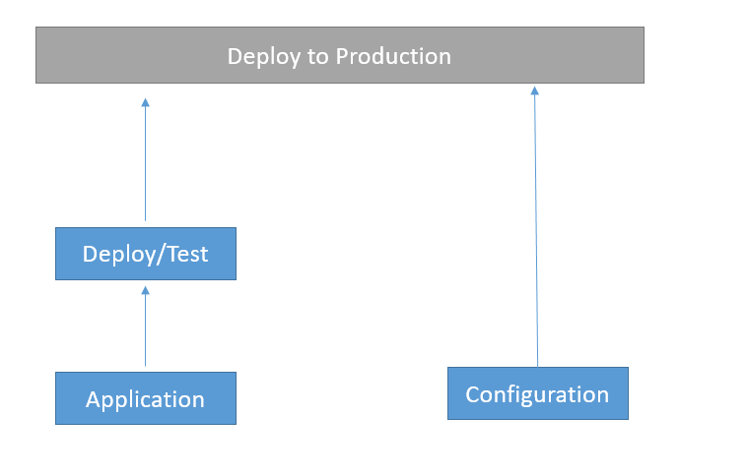
Centralized Configuration with Spring Cloud Config server
To externalize properties or resource files out of server where the values of those resources vary during runtime – usually different configurations that will differ in each environment.
Goals
Externalized (Property Files)
Environment Specific (Spring Profile)
Consistent
Version History
Real-time Management

Slide 25
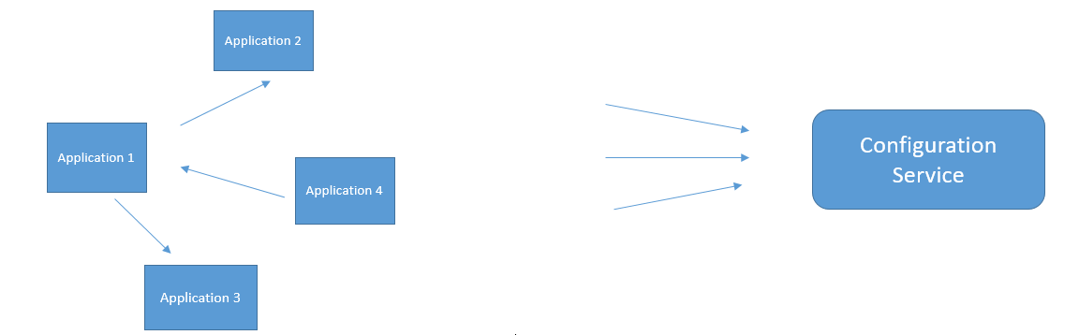
Centralized Configuration with Spring Cloud Config server
Achieving consistency across micro services difficult where each application holds its own configuration.
Configuration As Service
We can achieve this by
Apache Zookeeper
ETCD – distributed key-value store
Hashicorp Consul
Spring Cloud Config server

Slide 26
Question?

